Slide 1


Slide 2


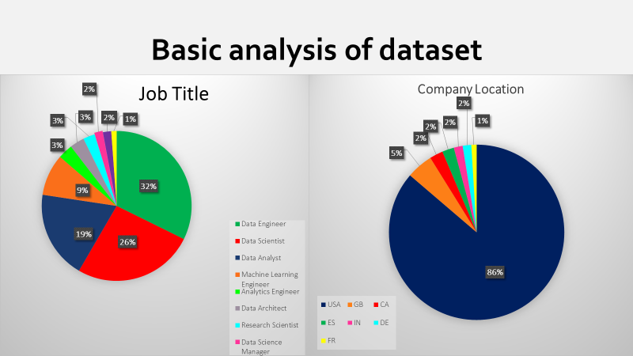

Slide 3
Data Science
Data science is a field that combines various techniques, algorithms, and tools to extract meaningful insights and knowledge from structured and unstructured data.
Data science typically involves the following key components:
Data Collection
Data Cleaning and Preparation
Exploratory Data Analysis (EDA)
Statistical Analysis
Machine Learning
Data Visualization
Data Interpretation and Communication

Slide 4
Data science salaries
Data science salaries can vary widely depending on several factors such as location, level of experience, industry, company size, and education.
Entry-level Data Scientist:
United States: $60,000 - $90,000 per year
Mid-level Data Scientist:
United States: $90,000 - $130,000 per year
Senior Data Scientist:
United States: $130,000 - $200,000+ per year

Slide 5


Slide 6
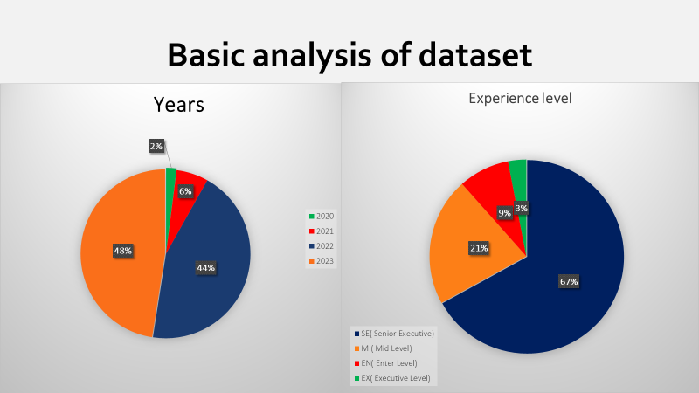

Slide 8
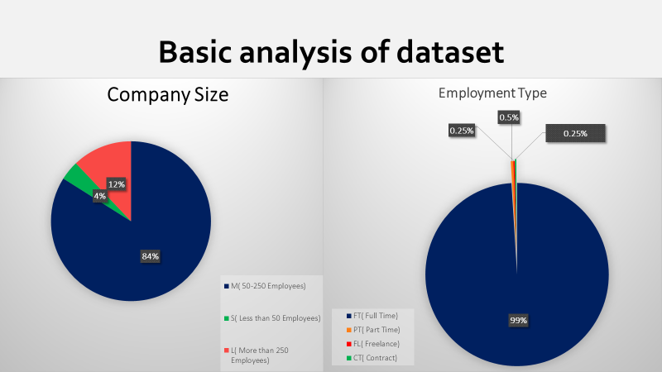

Slide 9
Data Approach
Standard Approach to Data
Best practices for best results
Application built with the user in mind

Slide 10
Cleanup
Data Cleaning Process
Accuracy for precision
Initial clean up
Missing Data
Criteria and Limitation
Data Checks (Plots & Info)
Data Encoding

Slide 11
Technologies
Primary Technologies
Sklearn, Matplotlib, Numpy, Panda, Streamlit, Pickle
Mean Absolute Error

Slide 12
Methodology and Results
Feature Understanding
Unique Values
Feature Importance
Correlation to target variable
Model selection
Supervised Learning models versus Neural Network models
Model evaluation metrics
Mean Absolute Error vs Mean Squared Error
Loss

Slide 13
Feature Understanding
Feature Importance |  |  | Feature Correlation to Target Variable (salary_in_usd)
employee_residence_US | 0.377367 |  | employee_residence_US | 0.483816
job_title_Data Analyst | 0.084665 |  | company_location_US | 0.466103
work_year | 0.045695 |  | experience_level_SE | 0.3499
experience_level_SE | 0.045121 |  | work_year | 0.22829
experience_level_EN | 0.042843 |  | company_size_M | 0.20183
*** | *** |  | *** | ***
employee_residence_SK | 0.00 |  | job_title_Data Analyst | -0.201951
job_title_Compliance Data Analyst | 0.00 |  | company_location_IN | -0.213313
job_title_Power BI Developer | 0.00 |  | employee_residence_IN | -0.22317
job_title_Principal Data Architect | 0.00 |  | experience_level_MI | -0.273791
company_location_AL | 0.00 |  | experience_level_EN | -0.285743

Slide 14
Model Selection
Mean Absolute Error for Supervised Learning Models
Loss for Neural Network Models

Slide 15
Metrics with All Features
Metrics with Unmodified Features
Model | MAE | MSE | RMSE | R2 Score
Random Forest | 3.60E+04 | 2.46E+09 | 4.96E+04 | 3.99E-01
Gradient Boosting | 3.67E+04 | 2.44E+09 | 4.94E+04 | 4.05E-01
Decision Tree | 3.75E+04 | 2.66E+09 | 5.16E+04 | 3.51E-01
KNN | 4.10E+04 | 3.11E+09 | 5.58E+04 | 2.42E-01
Gaussian Process | 4.34E+04 | 3.72E+09 | 6.10E+04 | 9.25E-02
Support Vector | 4.92E+04 | 4.10E+09 | 6.40E+04 | -2.34E-04
Linear Regression | 8.75E+16 | 1.04E+36 | 1.02E+18 | -2.55E+26

Slide 16
Metrics After Feature Modification
Metrics after Modifying the Features
Model | MAE | MSE | RMSE | R2 Score
Random Forest | 24471.55638 | 9.45E+08 | 30745.94613 | 0.297735
Gradient Boosting | 24475.83967 | 9.12E+08 | 30203.07189 | 0.322315
Linear Regression | 24568.16496 | 9.41E+08 | 30679.42407 | 0.30077
KNN | 25272.63733 | 9.94E+08 | 31531.03079 | 0.261413
Decision Tree | 25520.41757 | 1.05E+09 | 32364.8469 | 0.221834
Gaussian Process | 27420.23331 | 1.24E+09 | 35200.41995 | 0.079506
Support Vector | 30962.48642 | 1.36E+09 | 36931.47326 | -0.013255

Slide 17
Neural Network
Neural Network Model Metrics
Loss | Accuracy
35974.87891 | 2478224128
35611.73828 | 2433414144
35678.05469 | 2422271232
38254.86719 | 2796239872
Unsuccessful attempts at minimizing the loss function even after adjusting the NN parameters.

Slide 18
Demo

Slide 19
Sources
Links
Modules
Systems

Slide 20
Recommendation

